Slide 1
Techtonic Shift SPJIMR The Miner League | IIM Kashipur Members: Balamukundan V R Roopak M Dashboard Link : SPJain_TechTonic Shift - Balamukundan | Tableau Public

Slide 2
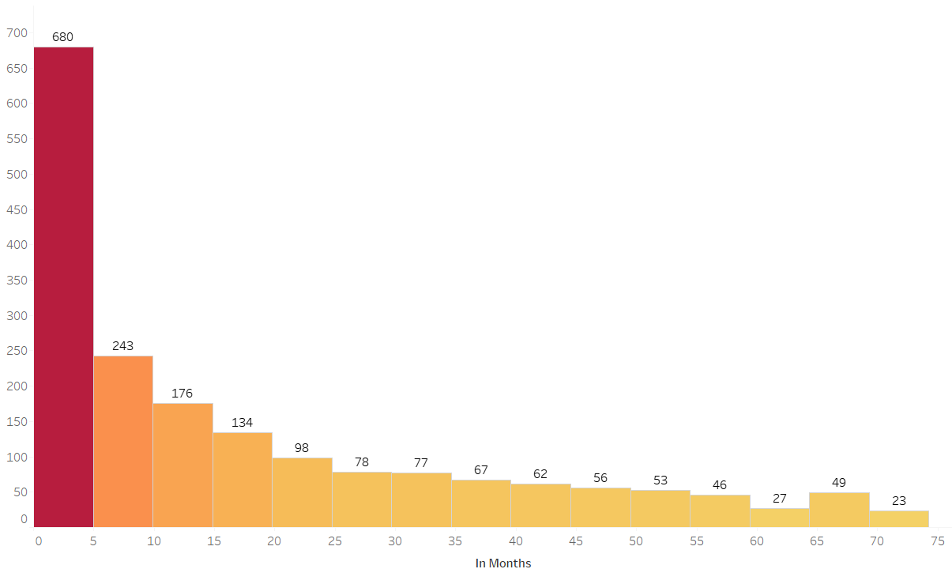
Churn Rate Vs Tenure
The churning is maximum at a shorter tenure
As the tenure increases the amount of churn drops significantly
The Telecom Company should focus more on retaining the customers during initial phase
Rewards and prices could be a possible way forward to retain the user initially

Slide 3
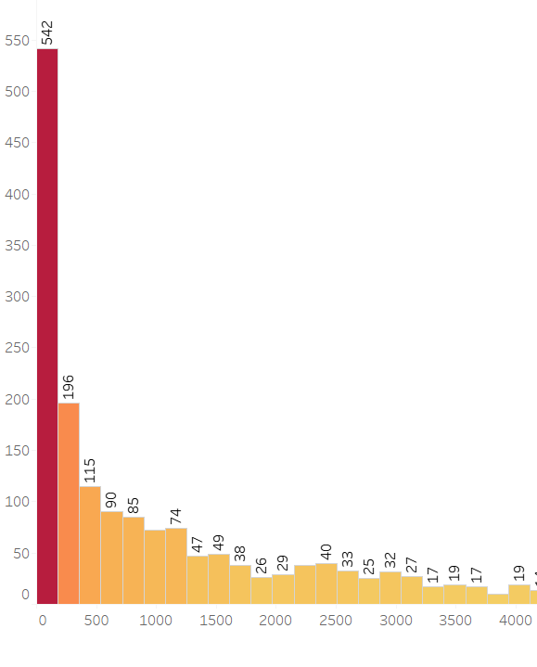
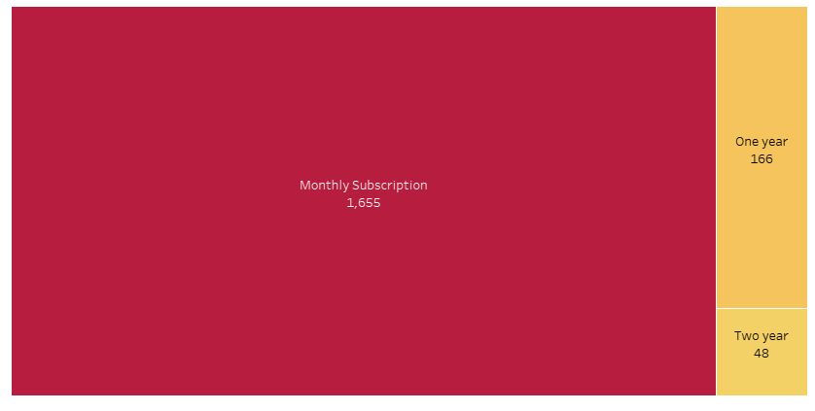
Churn is Higher among customers with Monthly Subscription
The churn is maximum among users having monthly subscription
Company could opt for Loyalty programs to retain customers
Churn is higher among users in Lower bracket of amount expended
This is in alignment users churning at lesser tenure
Trend indicates higher the tenure and subscription, lower the churn

Slide 4
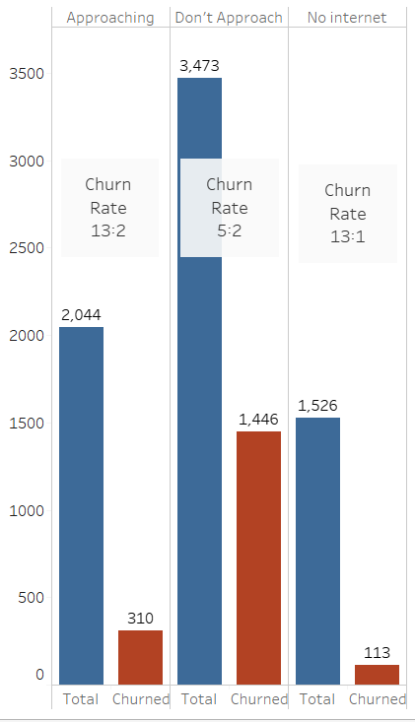
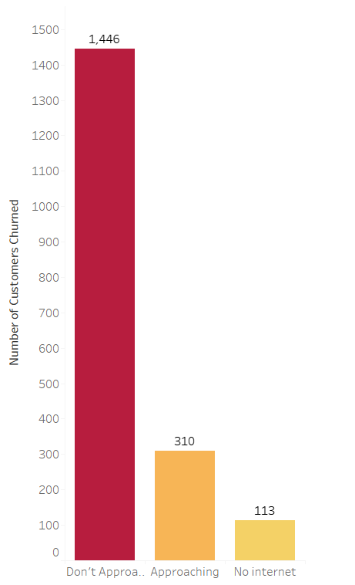
Churn Rate is Higher among users who do not approach Tech support
Observation
The Number of Customers churning is higher when the user do not approach the Tech support
The high churn can also be due to larger sample of total customers do not contact tech support
However, the ratio between the total users and churned customers is high in the category of users who do not contact tech support
Possible Reasons and Resolution
The high churn rate could be attributed to difficulty in customers reaching out to tech support
More seamless communication should be developed for communication with customers

Slide 5
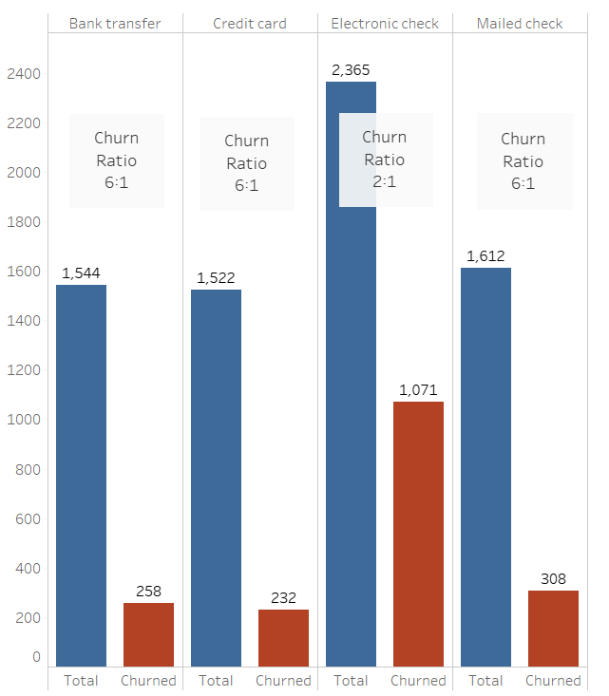
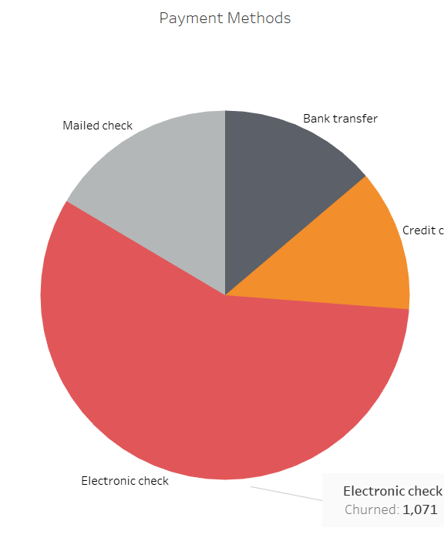
Customer Churn is Higher among users who use Electronic Check
Highest number of Users use Electronic check as payment method
Nearly half the number of electronic check users churned
The ratio is High (2:1) as compared to ratios of other modes of payment (6:1)
The company needs to monitor the customer activity in this mode of payment

Slide 6
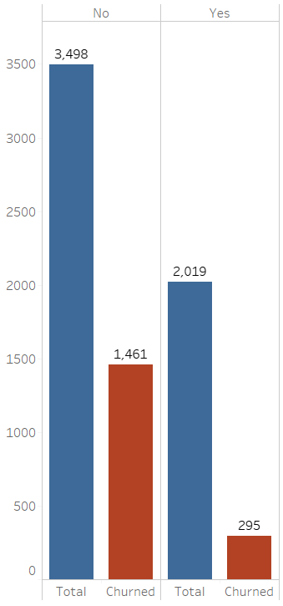
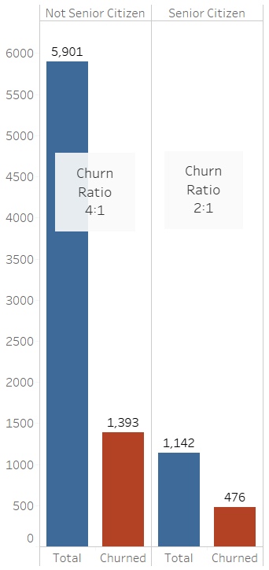
Some Common Trends
There’s a positive correlation between Customer Churn and Users having Online security
Users without Online security tend to churn more
The churn rate is higher among senior citizens (2:1) than Non – senior citizen (4:1)
The churn is higher among users with no Device Protection

Slide 7
THANK YOU

